Slide 1


Government Engineering College, Ajmer
Trained at: Netparam Technologies Pvt. Limited
IT Division :- CDAC - Jaipur

Slide 2
Understanding the App Community.
By :- Dhruv Marothi and Akshay Kumar Jain

Slide 3
Table of contents :-
1. Introductory Section
1.1 Motivation
1.2 Problem Statement
2. Methodology Section
2.1 Data Sources
2.2 Research Methods
3. Result Section
4. Conclusion

Slide 4


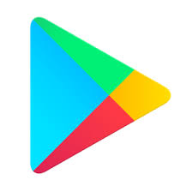
1.1 Motivation
1.There are approximately 3.6 million apps available on Google Play Store as per on March 2018. Thereby making Google Play Store the largest app store.
2. Android is the dominant mobile operating system today with about 85% of all mobile devices running on OS. The Google Play Store is the largest and most popular Android app store.
3. Over 125 apps have been downloaded approximately one hundred million times and around 1788 apps have been been downloaded at least ten million times.
4. 94.24 percent of apps in the Google Play app store were freely available.
5. Very few types of research have been conducted based on Android App which we have chosen, therefore, we found this topic more convincing for our research work and proceeded with this.

Slide 5
1.2 Problem Statement
The purpose of our project is to gather and analyze detailed information on apps in the Google Play Store in order to provide insights on app features & the current state of the Android app market.
To provide a solution which can give answers to the question’s related to Android App market and key Insight’s of Google Play Store (Such as :- What will be the rating of a new app in for a particular category, genres ?, Which is the best App ?, What type of Reviews a App receives ?)

Slide 6
2.1 DATA Sources
We collected descriptive information on over 9,366 apps across 33 different categories ( like:- Business, Food & Drink, Books & Reference, Travel & Local, Health & Fitness, News & Magazines, Education, Social, Finance, Medical, and Entertainment) in the Google App Store .
The dataset is chosen from Kaggle. It is the web scraped data of 10k Play Store apps for analyzing the Android market. It consists of in total of 9,366 rows and 13 columns which consists of App (Name) ,Category (App) ,Rating (App), Reviews (User), Size (App), Installs (App), Type (Free/Paid), Price (App), Content Rating (Everyone/Teenager/Adult), Genres (Detailed Category), Last Updated (App), Current Version (App), Android Version (Support).

Slide 7
2.2 Research Methods
1. Data Wrangling :- Data wrangling, sometimes referred to as data munging, is the process of cleaning and unifying messy and complex data sets for easy access and analysis.
2. Data Visualization :- Data visualization is the graphical representation of information and data. By using visual elements like charts, graphs, and maps, data visualization tools provide an accessible way to see and understand trends, outliers, and patterns in data.
3. Prediction Analytical :- Predictive analytics uses many techniques from data mining, statistics, modeling, machine learning, and artificial intelligence to analyze current data to make predictions about future. The data which can be used readily for analysis are structured data.

Slide 8
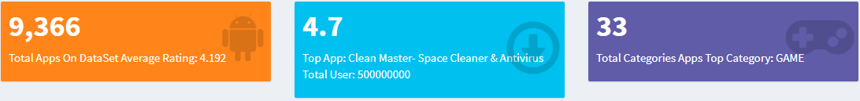
3. Result section
Highlights of the Data Set :-
Here,
We display the characteristics and nature of the dataset we have used in our project.

Slide 9
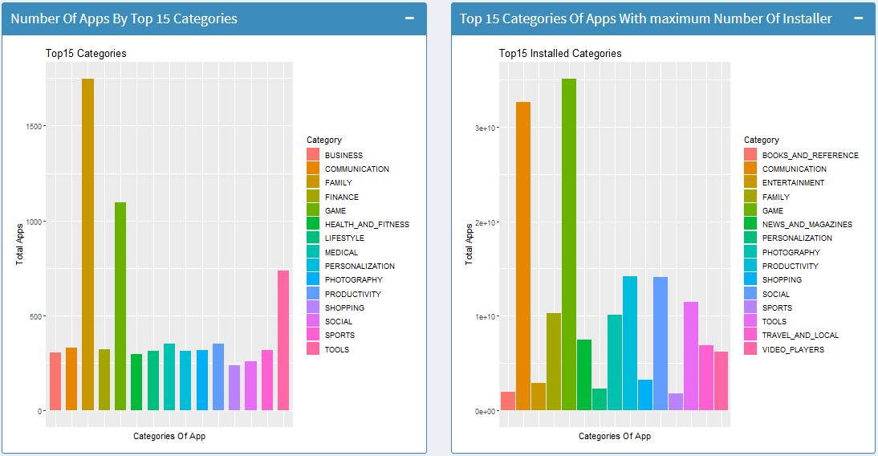
Relation between app and categories

Slide 10
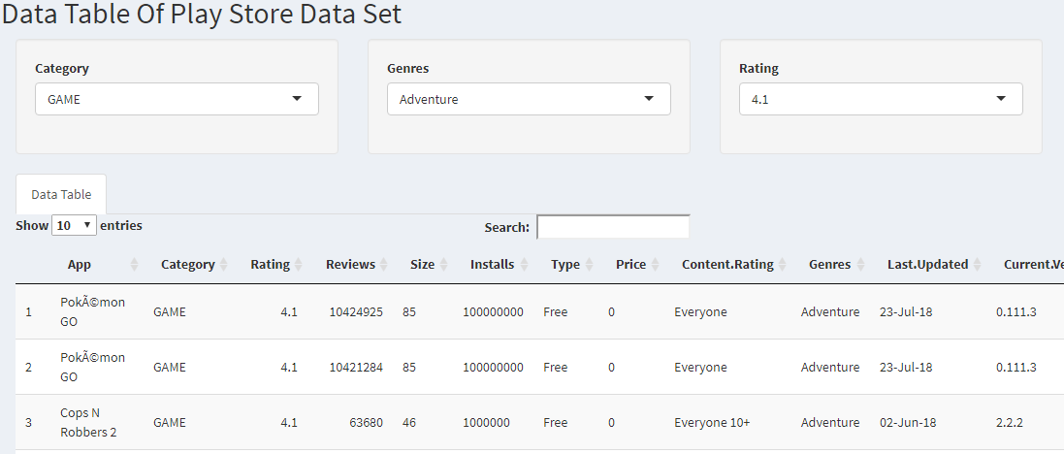
Data table
In this user can find any information present in our dataset in a structured way.

Slide 11
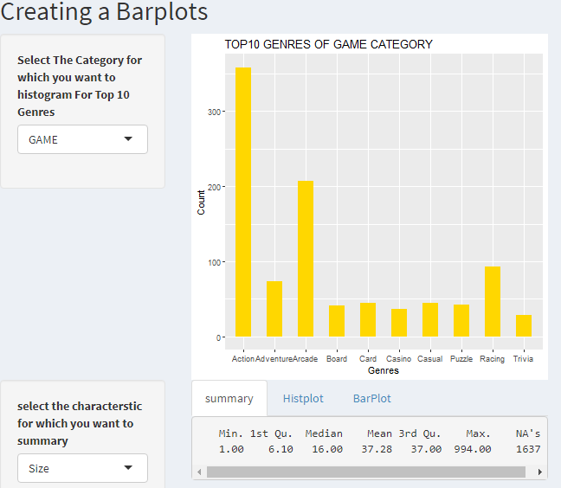
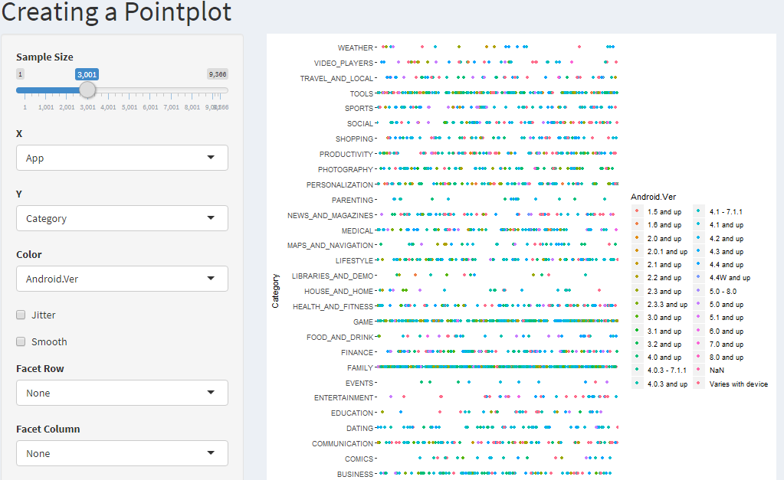
Graphical representation
BAR REPRESENTATION
POINT REPRESENTATION

Slide 12
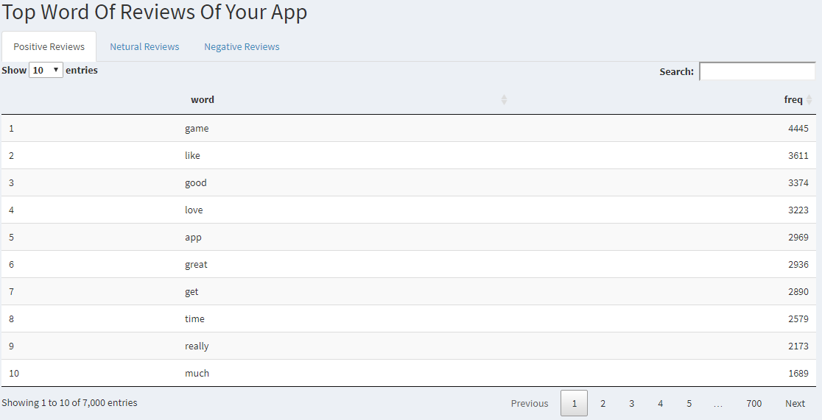
REVIEWS
Here, We have displayed specific keyword used in reviews on basis of their nature.

Slide 13
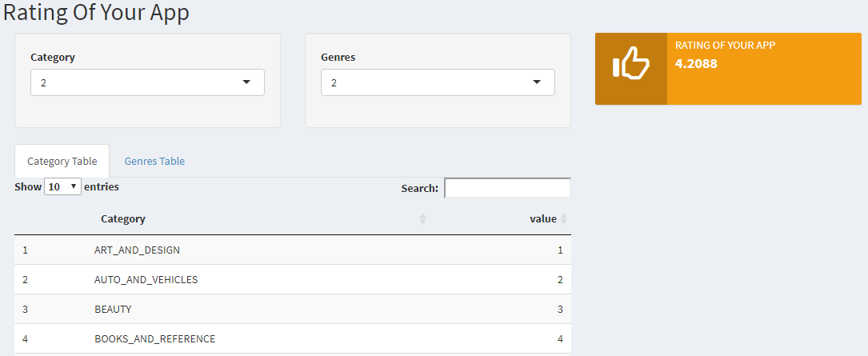
App rating predictor
Here , User can check their predicted rating of their app according to it’s Category and Genres.

Slide 14

4. Conclusion section
Prediction of the rating of an app of a particular category and genre
by using the regression model.
Structured representation of all the reviews in the form of specific
keyword on the basis of their nature in accordance to an app.
User can visualize the relationship between any attribute available
in the dataset according to his/her choice in a graphical manner.
A Comparison within the dataset that shows which app or category
is best and also shows the average rating of the apps present in the
dataset.

Slide 15
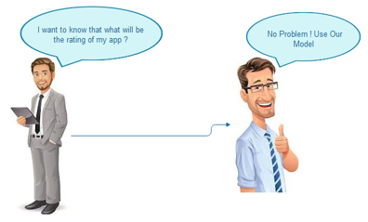
Target User and Market
Use Case of our Project
Our target users and market
Would be as follows
1. IT Companies :- Many IT Companies built an App focusing to get maximum revenue from it by targeting proper customers .To identify them they can use our project work for this purpose.

Slide 16
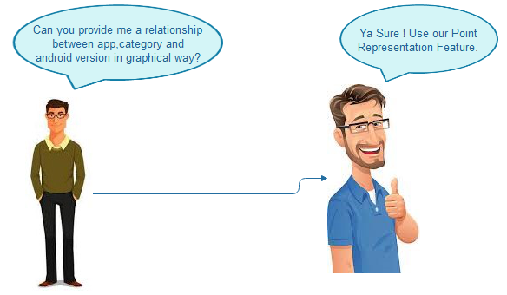
Target User and Market
Use Case of our Project
2. Developers and Analyst :-
A young developer who want to design an app can take help from our project and choose on which feature’s should he/she design his/her app.
A analyst can also take help from our project in analyzing the Contemporary App Market trends.

Slide 17
Future work and Concluding remarks
Future Scope :-
• Rating mismatch :- We could analyze all the reviews from top to bottom which will allow us to observe certain patterns in the dataset that could be translated into features. Using them we could try and build a model that could potentially identify if a review will result in a rating mismatch, or represent user dissatisfaction. If successful, this model could prevent developers from having an inflated or deflated view of how their app is performing.
• Data Visualisation Limitation :- Currently, There are approximately 3.6 million apps available on Google Play Store as per on March 2018. But here we are not able to visualize our whole dataset which only constitute approx. 10 thousand app clearly .Therefore, In future we could expect that new tools will be available which can visualize large set of data at once.

Slide 18

Conclusion :-
The Google Play Store is the largest app market in the world. It generates more than double the downloads of the Apple App Store , but makes only half the money as the App Store. There is also the problem of rating mismatch on a smaller scale. If this issue could be mitigated, the Play Store would provide a more accurate representation of user sentiment which in turn could help developers make adjustments to their app accordingly. Such as :-
Users tend to download a given app more if it has been reviewed by a large number of people.
Users are more critical and harsh while reviewing free apps. They are never extremely negative while reviewing a paid app.

Slide 19
Thank you!

